Slide 1
Genetic Change

Slide 2
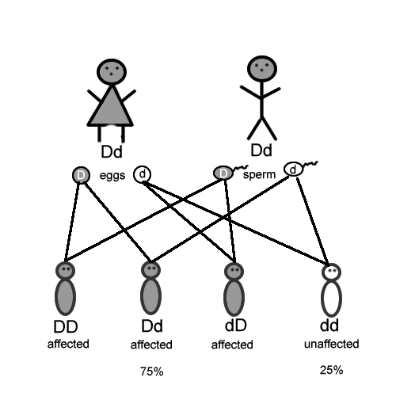
Alleles
Different forms of a trait.
Every person has 2 alleles.

Slide 3
Gene Pool
All the alleles present in a population.
Here is the gene pool for a sample population:
10 alleles are d (white)
06 alleles are D (black)

Slide 4
Genetic Drift
Random change in allele frequency within a population.
The gene pool has changed after several generations:
13 alleles are d (white)
03 alleles are D (black)

Slide 5
Genetic Drift
This may lead to the disappearance of an allele over time.
The gene pool no longer includes D:
16 alleles are d (white)
00 alleles are D (black)

Slide 6
Gene Flow
Movement of alleles from one population to another.
Sup.

Slide 7
Gene Flow
This may lead to new alleles in a population.
The gene pool now includes D:
12 alleles are d (white)
04 alleles are D (black)

Slide 8
Founder Effect & Bottle Necking
Video:
Founder Effect, Bottle Necking, and Genetic Drift

